Slide 1

Python exercise 3

Slide 2
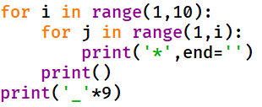
Question 1
What is the result of the following code after execution?
A. *
**
***
****
*****
******
*******
********
*********
_________
B. *
*
*
*
*
*
*
*
*
_________
C.
*
**
***
****
*****
******
*******
********
_________
D.
*
*
*
*
*
*
*
*
_________

Slide 3
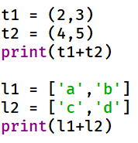
Question 2
What is the result of the following code after execution?
A. (2, 3, 4, 5)
[‘a’, ‘b’, ‘c’, ‘d’]
B. (6, 8)
[‘ac’, ‘bd’]
C. (2, 4, 3, 5)
[‘a’, ‘c’, ‘b’, ‘d’]
D. 2, 3, 4, 5
a, b, c, d

Slide 4
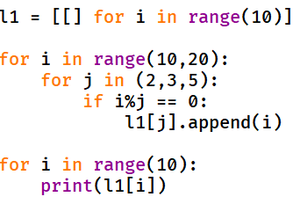
Question 3
What is the result of the following code after execution?
A. [10]
[11]
[12]
[13]
[14]
[15]
[16]
[17]
[18]
[19]
B. 10
11
12
13
14
15
16
17
18
19
C. []
[10]
[12]
[]
[15]
[]
[]
[]
[]
[]
D. []
[]
[10,12,14,16,18]
[12,15,18]
[]
[10,15]
[]
[]
[]
[]

Slide 5
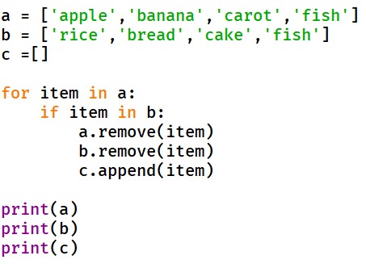
Question 4
What is the result of the following code after execution?

Slide 6
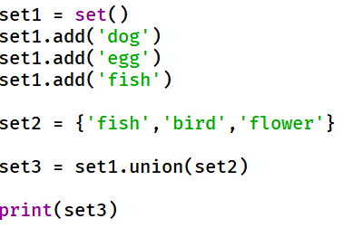
Question 5
What is the result of the following code after execution? (order may change)
A. ‘dog’, ‘egg’, ‘fish’, ‘bird’, ‘flower’
B. {‘dog’, ‘egg’, ‘fish’, ‘fish’, ‘bird’, ‘flower’}
C. ‘bird’, ‘dog’, ‘egg’, ‘fish’, ‘fish2’, ‘flower’
D. {‘dog’, ‘egg’, ‘fish’, ‘bird’, ‘flower’}

Slide 7
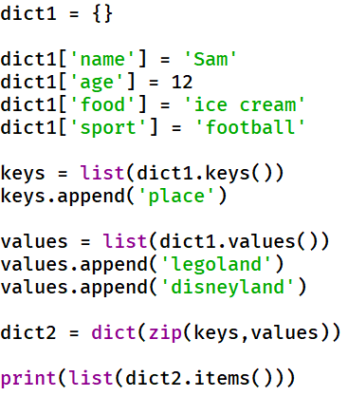
Question 6
What is the result of the following code after execution?
A. {‘name’:’Sam’, ‘age’:12, ‘food’:’ice cream’, ‘sport’:’football’}
B. [('name', 'Sam'), ('age', 12), ('food', 'ice cream'), ('sport', 'football'), ('place', 'legoland')]
C. [('name', 'Sam'), ('age', 12), ('food', 'ice cream'), ('sport', 'football'), ('place', 'legoland’), (‘place’, ‘Disneyland’)]
D. {‘name’:’Sam’, ‘age’:12, ‘food’:’ice cream’, ‘sport’:’football’, ‘place’:’legoland’}

